Slide 1
Label Propagation Using Amendable Clamping
○ Tatsurou Miyazaki
Tokyo University of Science
Yasunobu Sumikawa
Tokyo University of Science

Slide 2
Label Propagation Using Amendable Clamping
○ Tatsurou Miyazaki
Tokyo University of Science
Yasunobu Sumikawa
Tokyo University of Science
Notes:
発表時間 15~7min 質疑応答含んで20min
(Thank you for introduction.)
I’m Miyazaki from Tokyo University of science.
Today, I’d like to talk about Label Propagation Using Amendable Clamping.
Firstly, I’d like to show our research motivation.

Slide 3





Motivation
Notes:
Today, there are numerous digital data on the web.
For example, they are articles, tweets, pictures and so on.
So, it is important for us to classify these data.
Therefore, classification is one of the most important area in machine learning.

Slide 4


Motivation
Notes:
We want high quality data set for learning better classification.
Generally, we can obtain high quality data set by labelling manually.

Slide 5




Motivation
Notes:
Thanks to spread of the internet, we can work on the task with multiple people.
However, the task is still quite challenge.
I explain specific example using Wikipedia articles.

Slide 6


Motivation
Notes:
It is important for classification task to prepare numerous training data have categories.
We often use Wikipedia articles for training data, because Wikipedia has numerous articles and categories.
And, each article has some categories.

Slide 7
Motivation
Notes:
As you can see, this slide shows that each Wikipedia article has some categories.

Slide 8



Motivation
Notes:
Although the labels are manually assigned, there are occasion time that some suitable labels are missed.
I show one specific example that suitable labels are missed.
There are common category “Mass murder” in these articles,

Slide 9
Motivation
Suicide bombings is not assigned.
Notes:
however, although the Wikipedia article to the right may have same topic of “Suicide bombings”, “Suicide bombings” is assigned to only the article to the left.

Slide 10
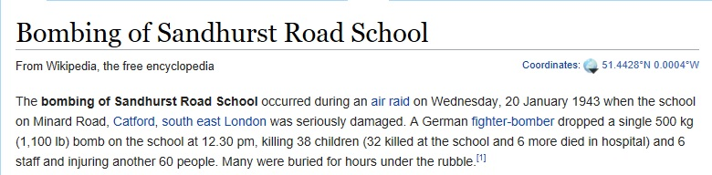
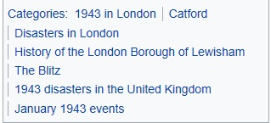
Motivation
Mass murder and Suicide bombings is not assigned.
Notes:
Although this article may have same topic as two articles introduced at one previous slide, these categories are not assigned to this article.

Slide 11
Motivation
Problem 1 : taking high cost
Semi-supervised learning is known as better approach.
Ex.) Lapel Propagation (LP)
Notes:
Using digital data for classification model construction, there are two problems.
First,
It takes high cost for us to work on the task as it increase the number of data.
So, it is difficult for us to prepare high quality numerous dataset.
Semi-supervised learning is known as one approach for solving this problem.
It is because that comparative to supervised learning, a little data is enough for semi-supervised learning.
I briefly explain the traditional algorithm called Label Propagation that is one of semi-supervised learning.

Slide 12
Motivation
Labeled data
Unlabeled data
0.07
0.81
0.62
Notes:
LP is semi-supervised learning for classification.
The algorithm assume that data that are similar to have the same label.
Label of data propagates to neighboring data according to their similarity.
There are weights that represent similarity between data.
The higher similarity is, the higher the value of weight is.
Then, labeled data are reset before the next propagating.
This process is called Clamping.
LP repeat both of propagation and Clamping until convergence.

Slide 13
Motivation
Problem 2 : the quality of dataset fall.
Wrong : Linear Neighborhood Propagation (LNP)
Missing : our proposed approach
Notes:
Second problem is that the quality of the dataset may fall when the dataset is assigned multiple labels.
Dataset might contain two kinds of labels.
One is wrong and the other is missing.
Some approach including Linear Neighborhood Propagation, LNP is the study of classification model construction using dataset including wrong labels.
LNP discovers the structure of the entire data set through the linear neighborhoods of each data.
While, our approaches is the study of classification model construction using dataset including missing labels.

Slide 14
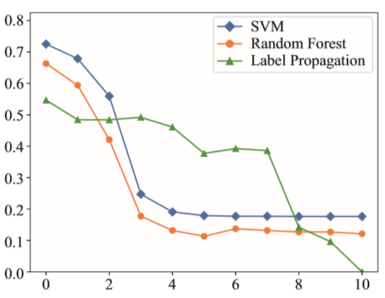
Effect of missing labels
The missing of labels is a serious issue for accuracy.
The micro-averaged F-scores
The number of missing labels
Notes:
The missing of labels is a very serious issue to achieve good accuracy because almost all classifiers assume that labeled data prepared by people are correct.
This graph shows how the missing of labels worsens accuracies of three algorithms, SVM, random forest and LP.
The vertical line shows the micro-averaged F-scores and the horizontal one shows the number of missing labels.

Slide 15
Effect of missing labels
The missing of labels is a serious issue for accuracy.
The micro-averaged F-scores
The number of missing labels
Notes:
As you can see, if only one label is missed, F-scores worsen by about 5%.

Slide 16
Effect of missing labels
The missing of labels is a serious issue for accuracy.
The micro-averaged F-scores
The number of missing labels
Notes:
If more than two labels are missing, the scores can decrease by about 10%.

Slide 17
Our approach
label propagation using amendable clamping (LPAC).
Objective: decreasing the impact of missing labels on accuracy.
Our approach is 45% higher than comparative approach.
document : 70%
label : 50%
Notes:
We propose a graph-based algorithm for multi-label classification, label propagation using amendable clamping.
We call this algorithm “LPAC”.
This algorithm can decrease the impact of missing labels on accuracy caused by labeling with multiple people.
The core process of our approach is to update the label of labeled data from their top-k similar data in each label propagation step.
For example, at most, our approach is maximum 45% higher than comparative approach when the ratio of documents that has missing labels is 70% and missing label is 50%.
I will come back to that point later. (8min)

Slide 18
Proposed algorithm: LPAC
Labeled data
Unlabeled data
Notes:
We extend the LP to make label propagation for missed labels by adding the two steps.
First, we extend this traditional LP by enhancing the propagation from similar data.

Slide 19
Proposed algorithm: LPAC
Labeled data
Unlabeled data
top-k of
Notes:
We can do this by just additionally propagate label only for top-k similar data.

Slide 20
Proposed algorithm: LPAC
Labeled data at nth iteration
Instead of clamping we set average values
Unlabeled data at nth iteration
top-k of
Notes:
Second extension is that we take cluster assumption, which means that the data tend to form discrete clusters, and points in the same cluster are more likely to share a label.
For this, LP apply to clamping to reset labeled data

Slide 21
Proposed algorithm: LPAC
Labeled data at nth iteration
Instead of clamping we set average values
Unlabeled data at nth iteration
top-k of
Notes:
but our approach update the values of labeled data by the average value of the top-k similar data for each data.
These values are set before invoking the next iteration.
LPAC repeat both two steps until convergence.

Slide 22
Experimental setting
Dataset | SIAM 2007 Text Mining Competition dataset
Labeled data | 4819
Unlabeled data | 4819
Classes | 22
Average number of label | 3.41
We apply latent dirichlet allocation (LDA) to our data.
Notes:
We used the SIAM 2007 text mining competition dataset.
This dataset is a subset of the Aviation Safety reporting system dataset.
It provides various types of aviation safety events reported by pilots, controllers, mechanics, flight attendants, and dispatchers.
In this dataset, there are 4819 labeled data, 4819 unlabeled data, and 22 classes.
On average, a labeled data is assigned 3.41 labels.
Then, we apply latent dirichlet allocation to our data in order to gain topic model.
We use the topic model to calculate the value of weight between data.

Slide 23

Experimental setting
The ratio of documents that has missing labels.
Ex.) Extraction ratio is 40%.
(2 documents / 5 documents)
Label A
Label B
Label A
Label C
Notes:
We first extract some data from this dataset to remove labels.

Slide 24
Experimental setting
The ratio of documents that has missing labels.
Ex.) Extraction ratio is 40%.
(2 documents / 5 documents)
Label A
Label B
Label A
Label C
Notes:
For example, when we remove labels of two documents of five ones, extraction ratio is 40%.

Slide 25

Experimental setting
The ratio of missing labels.
Ex.) Removal ratio is 50%.
(2 labels / 4 labels)
Label A
Label B
Label C
Label D
Notes:
Then, we remove labels for the data.

Slide 26
Experimental setting
The ratio of missing labels.
Ex.) Removal ratio is 50%.
(2 labels / 4 labels)
Label A
Label B
Label C
Label D
Notes:
For example. When we remove two labels of four ones, removal ratio is 50 %.
Both extraction ratio and removal ratio are increased from 0% to 100%.

Slide 27
Experimental setting
Comparative algorithm
LP (traditional)
DLP (Dynamic Label Propagation, state-of-the-art)
LNP (Linear neighborhoods propagation)
Random Forest
SVM
Notes:
We compared LPAC with five algorithm, LP, dynamic LP, LP through Linear Neighborhood, Random Forest and SVM.
DLP and LNP is the algorithm based LP.
DLP that is the state-of-the-art LP algorithm uses label correlation.

Slide 28
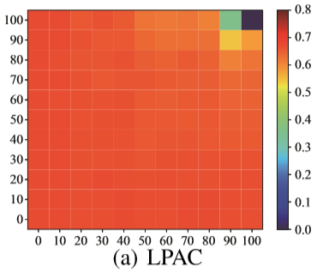
Micro-averaged F-scores for six classifiers
The x axis represents the ratio of documents that has missing labels.
The y axis represents the ratio of missing labels.
Notes:
The heat map shows the results of LPAC.
The x axis represents the extract ratio and y axis represents the removal ratio.
As you can see, the accuracies almost match the result achieved when the classifier is trained on a dataset that does not have missing labels.

Slide 29
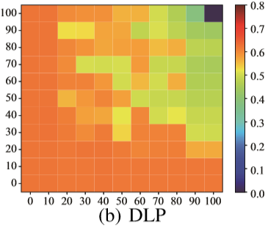
Micro-averaged F-scores for six classifiers
The x axis represents the ratio of documents that has missing labels.
The y axis represents the ratio of missing labels.
Notes:
The heat map shows the results of DLP.
The accuracies decrease once the extract ratio exceeds 30%.
Moreover, once the ratio reaches 50%, accuracies of one rapidly decrease.

Slide 30
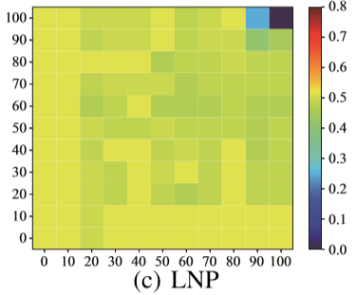
Micro-averaged F-scores for six classifiers
The x axis represents the ratio of documents that has missing labels.
The y axis represents the ratio of missing labels.
Notes:
The heat map shows the results of LNP.
The accuracies of LNP also decrease once the extract ratio exceeds 30%.
The accuracies of LNP decrease more slowly than ones of DLP.
Note that LNP also tend to keep this accuracies, but the scores are lower than LPAC.

Slide 31
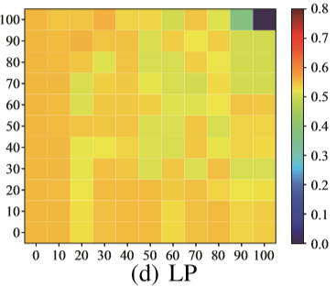
Micro-averaged F-scores for six classifiers
The x axis represents the ratio of documents that has missing labels.
The y axis represents the ratio of missing labels.
Notes:
The heat map shows the results of LP.
The accuracies of LP also tend to slowly decrease.
Note that, LP also tend to keep this accuracies, but the scores are lower than our approach.

Slide 32
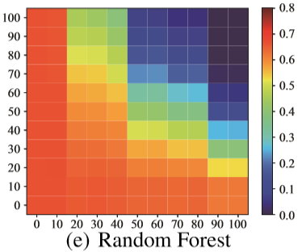
Micro-averaged F-scores for six classifiers
The x axis represents the ratio of documents that has missing labels.
The y axis represents the ratio of missing labels.
Notes:
The heat map shows the results of random forest.
Comparative to LP based algorithm, the accuracies of Random Forest rapidly decrease.
In particular, once removal ratio reaches 50%, accuracies of random forest decrease from about 10% to 50%.

Slide 33
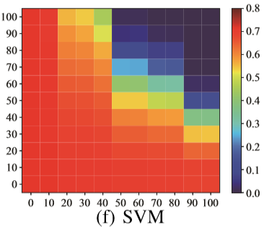
Micro-averaged F-scores for six classifiers
The x axis represents the ratio of documents that has missing labels.
The y axis represents the ratio of missing labels.
Notes:
The heat map shows the results of SVM.
The accuracies of SVM rapidly decrease like random forest.

Slide 34
Conclusion
We propose a multi-label classification (LPAC) for a moderately challenging multi-labeling task.
Propagating labels according to top-k similar data.
Updating labeled data by taking cluster assumption.
Notes:
In this work, we propose a multi-label classification to apply to moderately challenging multi-labeling task.
LPAC extend LP by two steps.
1.Propagating labels according to top—k similar data.
2.Updating labeled data by taking cluster assumption.
These two extensions make the f-score of LPAC stable compared to those of algorithm proposed by previous work.

Slide 35
Conclusion
We propose a multi-label classification (LPAC) for a moderately challenging multi-labeling task.
Propagating labels according to top-k similar data.
Updating labeled data by taking cluster assumption.
Future work
The effective utilization of label correlation.
How effectively our algorithm works on a real dataset.
Establishing algorithm that can be trained on dataset including both of wrong and missing.
Notes:
There are three our future work.
First, once LPAC is extend to take care of label correlation, we can implement label recommendations.
Second, we will identify how effectively LPAC works on a real dataset that contains missing labels data like Wikipedia as discussed in motivation.
Finally, we will study establishing algorithm that can be trained on dataset including both of wrong and missing.
Although our approach assumes that there are no data attached any wrong labels, real datasets might contain both of the two kinds of labels at the same time.
We will explore how to reduce the noises.
Thank you for very much for kind attention.
I’m not following you. Can you rephrase that more simply? I see.
Are you asking ; what’s the status of ~

Slide 37
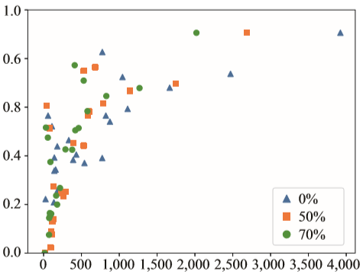
Correlation between the number of training label and F-scores of LPAC
The micro-averaged F-scores
The number of training data in each category
Notes:
This slide shows that the correlation between F-scores and the number of labeled documents for LPAC.
We plot results of three cases where 0%, 50% and 70% of documents had missing labels.
As you can see, there is a positive correlation between them.
(The correlation coefficiencies of them are 0.76,0.72 and 0.75)
So, we can say that the more there are correct labels are assigned to training data, the better accuracy we can obtain.

Slide 38
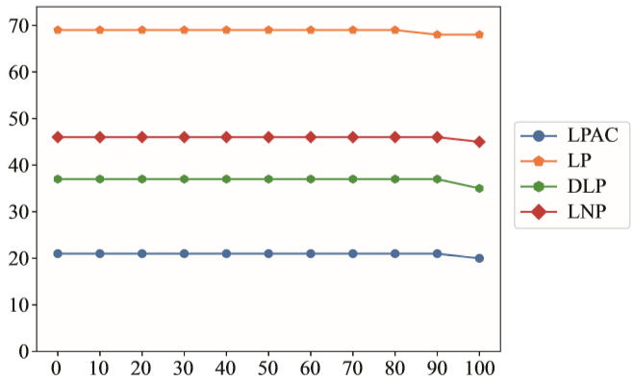
The number of iterations of LP-based algorithms
The number of iteration
The number of missing labels when 10% of documents had missing labels.
Notes:
This slide shows that how many iterations each LP-based algorithm needs to convergence the propagating labels.
As you can see, LPAC is the lowest of the four LP-based algorithms.
This is because that LPAC makes label propagation by averaging label values of not only all data but also ones of similar documents in order to enhance take cluster assumption during propagating labels.

Slide 39
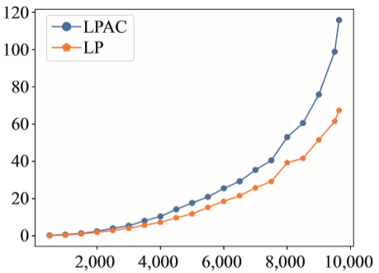
The analyzing time of LP and LPAC
Analyzing time (seconds)
The size of training datasets
Notes:
This slide shows the analyzing time of LP and LPAC.
As you can see, the both of the two lines draw exponential growth.
The analyzing time of LPAC is about twice as slow as the one of LP if we use 10,000 data, however it is not problem for many objectives since the analyzing time of LPAC is about two minutes.

Slide 40
The analyzing time of LP based algorithm
algorithm | Analyzing time [sec]
LPAC | 115.8
LP | 67.3
DLP | 8399.7
LNP | 3477.1
Notes:
The slide shows the analyzing time of four LP-based algorithms when the number of training data and test data is 4819 respectively.
DLP and LNP takes long time to analyze.
While, the analyzing time of LPAC and LP is practice.

Slide 41
Experiment using Wikipedia
Notes:
We experiment using Wikipedia.
“106 Davao City bombing” and “2016 Brussels bombings ” have common labels.
Although “Bombing of Sandhurst Road School ” have same topic as these two articles, this article does not have common labels with them.
When we use dataset including these articles for training data, we study the effect of them for classification.

Slide 42
Experiment using Wikipedia
Labels of Wikipedia | The number
Disasters in city | 29
Terrorist incident | 71
Mass murder | 130
Suicide bombings | 106
Labeled data | 170
Unlabeled data | 100
Notes:
We use the articles belonging to four labels, Disasters in city, Terrorist incident, Mass murder and Suicide bombings.
The number of articles in each label are as you can see.
The number of labeled data and unlabeled data are 170 and 100 respectively.

Slide 43
Experiment using Wikipedia
algorithm | F-scores [%]
LPAC | 0.544
LP | 0.522
DLP | 0.519
LNP | 0.457
Notes:
This slide shows the F-scores of four LP-based algorithms.
LPAC is the most high score of else algorithms.

Slide 44
Experiment using Wikipedia
Assigned two labels
Disasters in City
Mass murder
Notes:
And, this article is not assigned label of "Mass murder "before applying LPAC.
Nevertheless, we can see that it is assigned the labels of disasters in city and mass murder after applying LPAC.
Therefore, we can expect that LPAC will be able to decrease the impact of missing labels of real data on accuracy.

Slide 46
New York Times and Japan Times
Dataset A : New York Times
Dataset B : Japan Times
○ digital
× technology
economy
technology
winter-olymics-2018
Reassign labels of articles of Japan Times
Notes:
We sometimes use digital data belonging to different dataset to train classifier.
So, we should reassign their labels.
Then, we experiment using articles of New York Times and Japan Times.
We use articles of New York Times for training data and Japan Times for test data.
Note that, there is the label of technology in New York Times, but there is not in Japan Times.
Japan Times has labels of digital that close to technology meaning .
So, we check that LPAC can reassign labels of articles of Japan Times to technology.

Slide 47
New York Times and Japan Times
Labels of New York Times | The number
Technology | 20
Economy | 20
Winter-Olympics-2018 | 17
Labels of Japan Times | The number
Digital | 15
Economy | 16
Notes:
We use the articles belonging to three and two labels in New York Times and Japan Times respectively.

Slide 48


New York Times and Japan Times
digital → technology
Notes:
This slide shows the result after applying LPAC.
These articles belong to Japan Times and have label of digital.
However, when we apply LPAC to these articles, they are reassigned label of technology.
Therefore, we can expect LPAC for interaction.

Slide 49
Notes:
Ｗｉｋｉｐｅｄｉａ3クラス問題

Slide 50
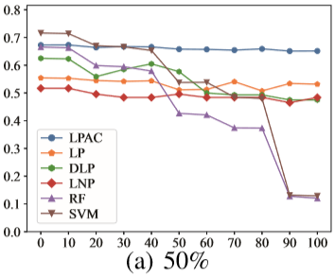
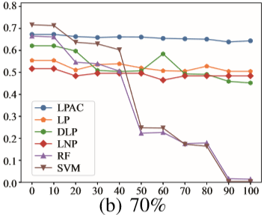
Micro-averaged F-scores for six classifiers
The x axis represents the ratio of missing labels.
The y axis represents the micro-averaged F-scores.
Notes:
This slide shows that their F-scores in the cases that we extracted 50 % and 70% of documents for removing labels, respectively.

Slide 51

Micro-averaged F-scores for six classifiers
The x axis represents the ratio of missing labels.
The y axis represents the micro-averaged F-scores.
Notes:
When the ratio of 50%, the accuracies of DLP, Random Forest and SVM begin to more early decrease than from 0% to 40%.

Slide 52
Micro-averaged F-scores for six classifiers
The x axis represents the ratio of missing labels.
The y axis represents the micro-averaged F-scores.
Notes:
Moreover, when the ratio of 70%, the accuracies of random forest and SVM sharply fall.
The accuracies of almost all comparative algorithms begin to decrease when the ratio of missing labels exceeds 20%.
In contrast, LPAC maintains a stable accuracy for all ratios of missing labels.

Slide 53
モチベーションの流れ
Web上にデータが膨大に増えているから、分類器大事
質の良い分類器を構築するためには質の良いデータセットが欲しい
通常、人がラベル付けすると良いデータセットが得られる
インターネットが普及してきて、このタスクを複数人で行えるようになってきた
しかし、まだ難しい
具体例：Wikipedia
データの量が増えるとコストがかかるし、
半教師あり学習が良いアプローチとして知られている (LP)
複数のラベルを持つ状況ではデータセットの質の低下
誤り (LNPとかがやってきた)
付与忘れ <- 本研究
Notes:
(文書だけでなく他のデータも）
分類器がどう研究されてきたのか
なぜグラフベースが良いのか、着目したのか
半教師ありでデータ量少なくて良い
質の良い分類器を構築するためには質の良いデータセットが欲しい、通常人がラベル付けすると良い
でも量が増えると辛い(コストがかかる）ー＞半教師ありが良い
さらに、インターネットが普及してきて、このタスクを複数人で行えるようになってきた
インターネットユーザが増えてきたおかげで、複数の人でラベルを付与することができ、このタスクはいくらか容易になっている

